Slide 1



Day 30
contact@anubhavtrainings.com
ABAP RESTFUL APPLICATION PROGRAMMING

Slide 2

Agenda – Day 30
Development Flow
Create Base CDS View
Understanding Base Behaviour Definition
Implementation of Base Behaviour Definition
Create Projection CDS View for Processor
Create/Implement Behaviour Definition for Processor
Create Service Definition to Expose Entity
Implement Service Binding

Slide 3


Our Demo Scenario
This demo scenario uses two projections with a different service scope. The resulting apps represent two role-based approaches to managing travels.
One business object projection uses the BO characteristics and the operations that are relevant for processing travel data. This resulting UI service serves the role of a data processor. The responsible person can enter the information about travels, bookings into the role-based app for processing travel data. This person needs functionality to create, update and delete entries on all three tiers of the business object. In addition, the action CreateByTravelTemplate is designed to facilitate the creation of new travel entries. The instance-bound action reads the values of the selected entry and creates a new entry based on these values with some deviations for the TravelID and the travel dates.
The other business object projection is the basis for a UI service that contains the functionality that is relevant for an approver. Imagine a person, maybe a manager of a travel agency, that approves the data that was entered by the processor. That means, this person sees the travel information and the corresponding booking data. Based on this data, the approver can either accept or reject the travel. For a minimal scope of fields in the travel entity the approver is enabled to edit the values, for example the BookingFee or the Description. The information about bookings is set to read-only for the approver. The approver is not allowed to change the fields of the booking entity.
Processor
Approver

Slide 4
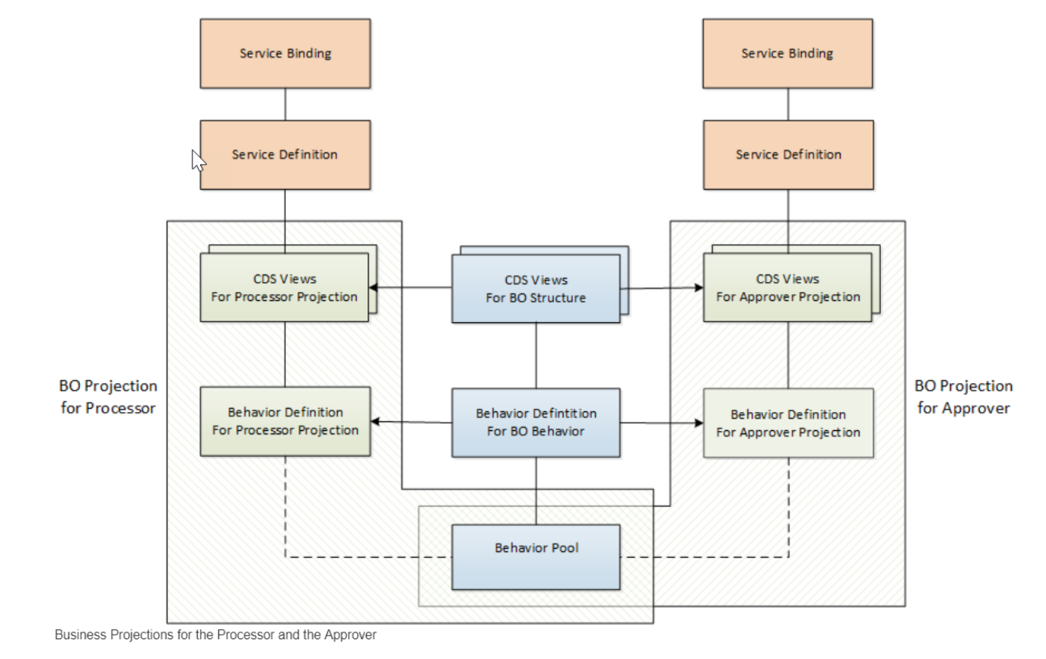
Projections

Slide 5
Introduction – Flexible Service Consumption
For a more flexible service consumption, every transactional business object is projected into a service specific context. In other words, only those elements of the data model and those behavior characteristics and operations that are needed in the relevant business service context are exposed for the service.
By means of projections, you can expose one BO in different business contexts by using different BO subsets. The general business logic is defined in the BO whereas the BO projection adopts a subset of the business logic.
A layering with projections enables robust application programming. You can change or enhance the BO without changing the exposed service as the scope of the service is defined in the projection layer. Enhancing the business object with additional structure or behavior does not have any effect on the resulting service.

Slide 6
Development Flow
4. Imp Behavior Definition on top of Projection View’s of Processor App.
7. Imp Behavior Definition on top of Projection View’s of Approver App.
2. Imp Behavior Definition on Travel.
6. Create Service Binding on top of Service Definition.
10. Create Service Binding on top of Service Definition .
1
3
5
7
9
2
4
6
8
10
1. Create Basic CDS View’s
For Travel & Booking.
3. Create Projection CDS on top of Basic View’s for Processor App.
5. Create Service Definition for Processor App.
7. Create Projection CDS on top of Basic View’s for Approver App.
9. Create Service Definition for Approver App.

Slide 7
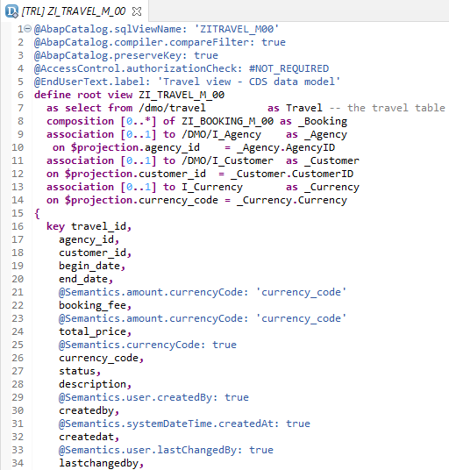
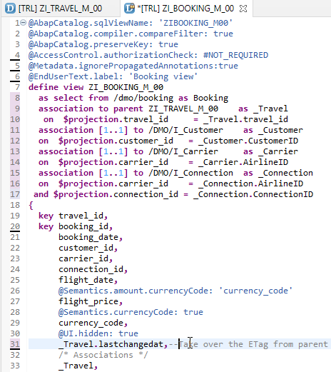
Create Base CDS View
ZI_TRAVEL_M_00
ZI_BOOKING_M_00

Slide 8
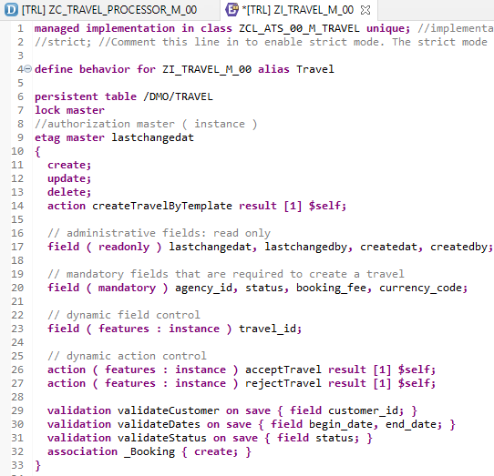
Implementing Base Behavior Definition
In the Project Explorer view of your ABAP project (or ABAP Cloud Project), select the node for the data definition that defines the root entity ZI_TRAVEL_M_XX. Open the context menu and choose New Behavior Definition to launch the behavior definition creation wizard.
“ZI_TRAVEL_M_00”
Behavior Definition for Base CDS’s Views .

Slide 9
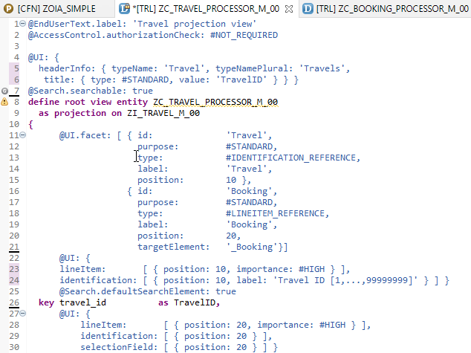
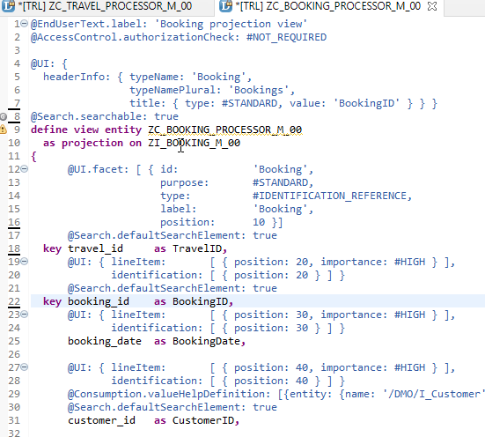
Projection CDS View’s for Processor
Projection CDS View for Travel Info “ZC_TRAVEL_PROCESSOR_M_00”
Projection CDS View for Booking Info “ZC_BOOKING_PROCESSOR_M_00”

Slide 10
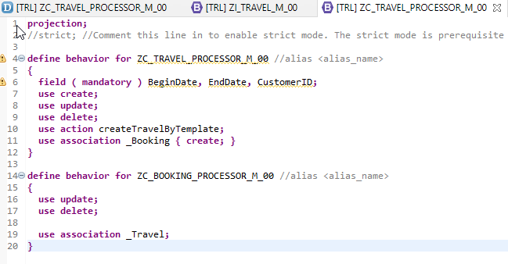
Behaviour Definition for Processor
The behavior for the BO projection is defined in a behavior definition of type projection. The type is defined in the behavior definition header. The projection behavior definition provides the behavior for the projection CDS view. All characteristics and operations that you want to include in the BO projection must be listed explicitly
“ZC_TRAVEL_PROCESSOR_M_00”
Behavior Definition for Projection CDS’s Views of Processor.

Slide 11
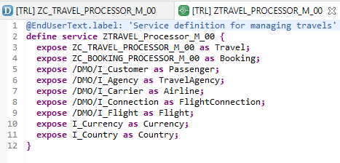
Service Definition
The service definition is a projection of the models and related behavior that you want to expose. In a service definition, you define the OData service to determine which CDS entities are part of the service. This service is then bound to a protocol and to either a UI technology or an A2X service by a service binding artifact. A service definition can be integrated in various protocols without any reimplementation.
Exercise
“ZTRAVEL_PROCESSOR_M_00”
Service Definition for Expose Entity

Slide 12
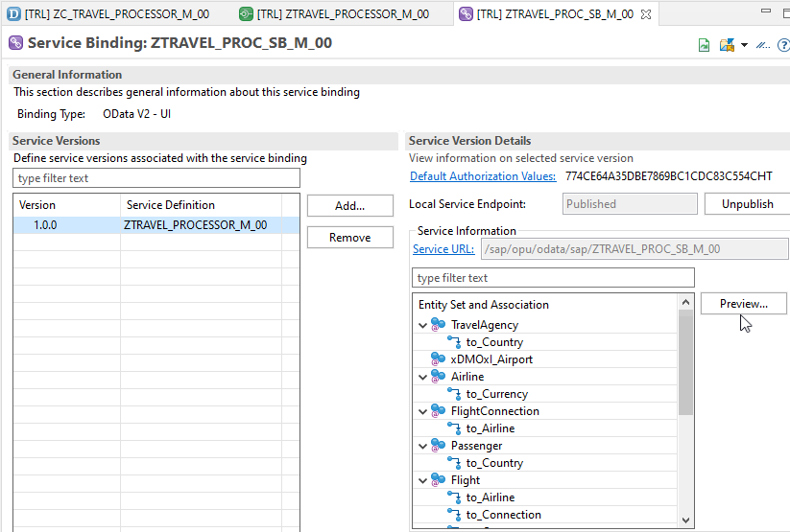
Service Binding (OData)
A service binding implements the protocol that is used for the OData service. It uses a service definition that projects the data models and their related behaviors to the service.
After Creating Service Binding , Select Entity and Click on Preview

Slide 13
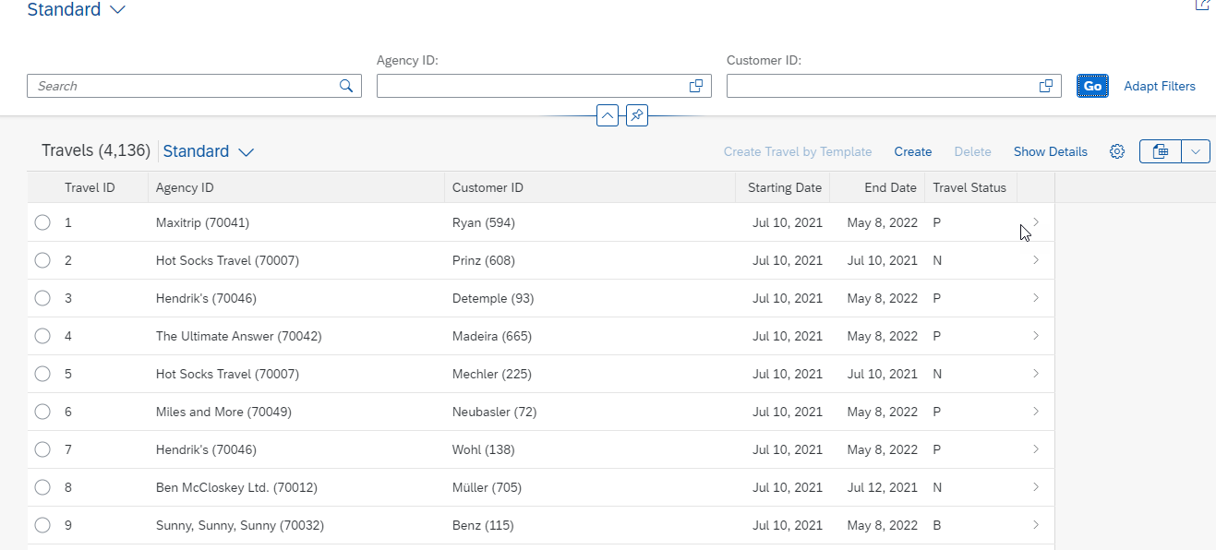
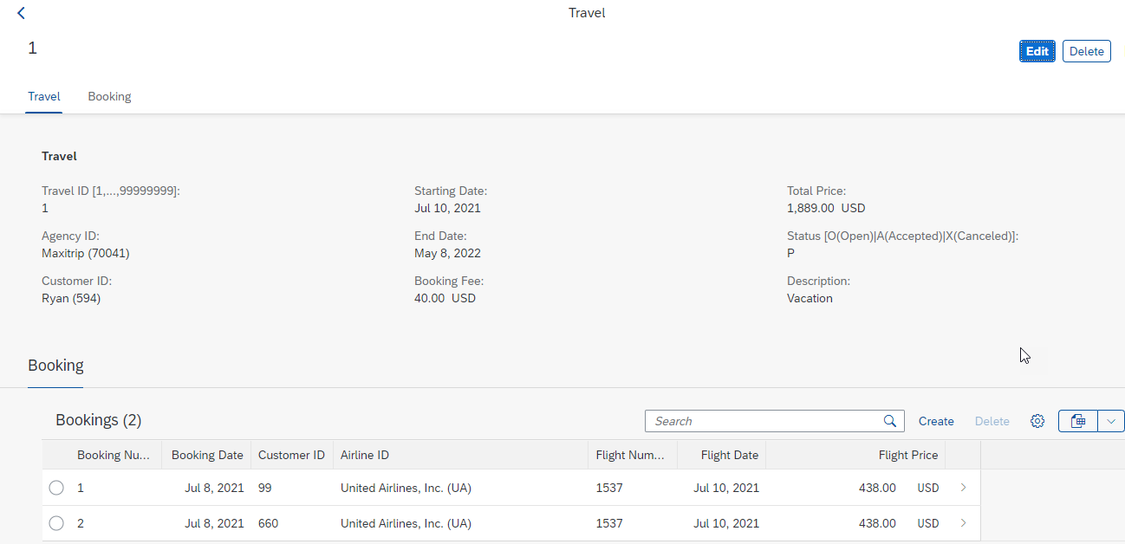
Final Result of Processor App
1st Screen with Search Bar & Filter Bar
2nd Screen with Travel and Booking Data,
& C-R-U-D Functionality

Slide 14

End of Day 30
Trainer: Anubhav Oberoy

Slide 15
Trainer: Anubhav Oberoy

Slide 16
THANK YOU
If you cannot do
great things, do small things in a great way.
Anubhav Oberoy
https://www.anubhavtrainings.com

Slide 17


We’re committed to empower you to be
Most Desirable Resource
through powerful training solutions.
We build the workforce of the future.
250+
Corporate Clients
30,000+
Learners Trained
25000+
Learners Placed
FREE WEBINARS
Sign up for free webinars with industry experts every fortnight!
Enroll Now!
Contact us today!
https://anubhavtrainings.com/

Slide 18




More from AnubhavTrainings.com

